Slide 1
Independent advice on law reform
Tikanga Māori Project

Slide 2
Overview
Context
Tikanga
State Law and Tikanga
Illustrations
Notes:
Intro notes:
Not expert in tikanga!!
Acknowledge assistance from Awanuiārangi, leading jurists, late Moana Jackson and Associate Prof Tomas (doctoral thesis required reading)

Slide 3
Our starting point
Tikanga : the set of values, principles, understandings, practices, norms, and mechanisms from which a person or community can determine the correct action in te Ao Māori
                Tā Edward Taihakurei Durie
Notes:
Tikanga and “law” not co extensive – reductive
Tikanga much broader: ethics, morality, metaphysical, physical constructs,
Tikanga is tikanga

Slide 4
Context
                Time of transition
Notes:
Explosion of activity
Custom law
Part of the values of the common law
Law (in te ao Māori)
An integrated system of principles

Slide 5
Te Wharenui
Cognitive Shift
Notes:
Mead, Pou, Doherty, Turehira,
The problem of dimension – framing engagement, building appreciation – the cognitive shift
Te ao Māori expressed and lived – āronga (Charles Royal)
A path to knowledge
A framing and memory device for our study paper and future engagement
Challenging for non-Māori – concerns “tapuise” tikanga – but any commitment to authenticity demands

Slide 6
Tikanga normative framework
He korowai tāwharau
Notes:
A sheltering cloak (tawharau concept Ta and Ka Williams – mana)
Surprise – beauty of its coherency
Not “legal archaeology
Living coherent normative system
Served the needs of Māori communities
Orders relationships / protects

Slide 7
Tikanga normative framework
An integrated system of norms
Notes:
Not simply “custom”
Norm includes principle, value, rule or standard that most significantly is lived and practiced, constantly evolving in response to community needs but in a way that maintains the coherency and integrity of the norm.
A norm is not limited to abstractions, which is important because positivistic law, unlike tikanga tends to abstract and commodify our relationship to each other and the environment, whereas tikanga seeks to affirm and maintain our connection to each other and the environment as a lived social practice
Wairua – Māori reality
Concepts of connection – structural norms – whakapapa and whanaungatanga
Concepts of equilibrium and balance – prescriptive values – mauri, utu, ea
Concepts of relational status – mana, tapu and noa
Concepts of responsibility – kaitiakitanga, manaakitanga, aroha
Processes and procedures – kawa

Slide 8
Tikanga normative framework
Te Ao Māori - Wairua
Notes:
Existential premise, underpinning of tikanga
Wairua: explains that we live in dual realities

Slide 9
Whakapapa and whanaungatanga
Concepts of connection – the frame
Whakapapa maps connections between all things
Whanaungatanga is the glue that binds
Notes:
Structural norms – frame all relationships – through time and space.

Slide 10
Mauri, utu and ea
Prescriptive concepts of balance and equilibrium:
Mauri – life force or essence
Utu – principle of reciprocity
Ea - conditions have been met, issues resolved
Notes:
Make demand for their maintenance
Relationships strive to achieve these things
Guide, and resolve

Slide 11
Mana, tapu and noa
Relational concepts
  Mana refers to authority or power and concomitant responsibility
  Tapu denotes restriction reflecting inherent worth or danger
  Noa refers to freedom to or from certain things (and a state of relative normality)
Notes:
Closest equivalent to jural concepts and jural relations – power, liability, rights, duty, freedom or privilege, immunity
Not exact equivalent – strongly recommended do not attempt to draw direct comparison

Slide 12
Tikanga processes: kawa
The regulator of mana, tapu, and noa
Notes:
Kawa is the regulator of mana, tapu and noa through ritual and procedure
Kawa has been described to us as “tikanga wrapped in tapu” and is thus less
susceptible to change than tikanga
Examples of kawa are karakia, pōwhiri, rāhui and muru

Slide 13
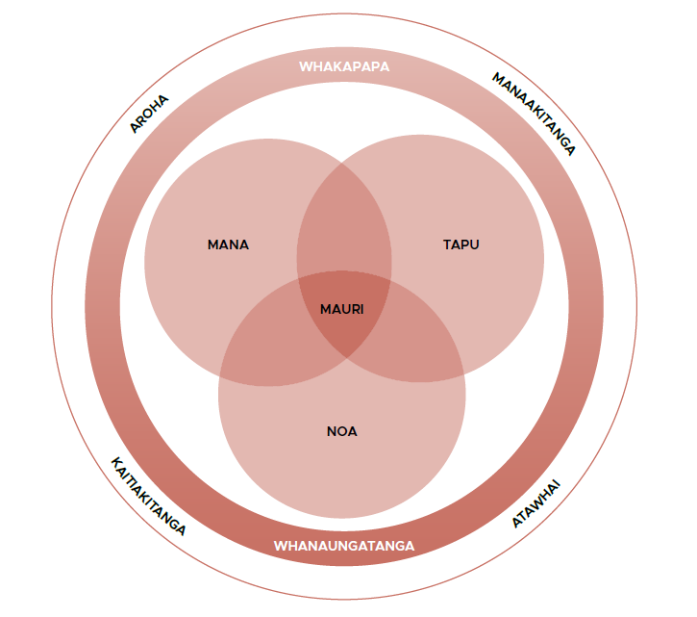
Mana, tapu, and noa
Notes:
Picture not made the cut – personal reflection of jural relations

Slide 14
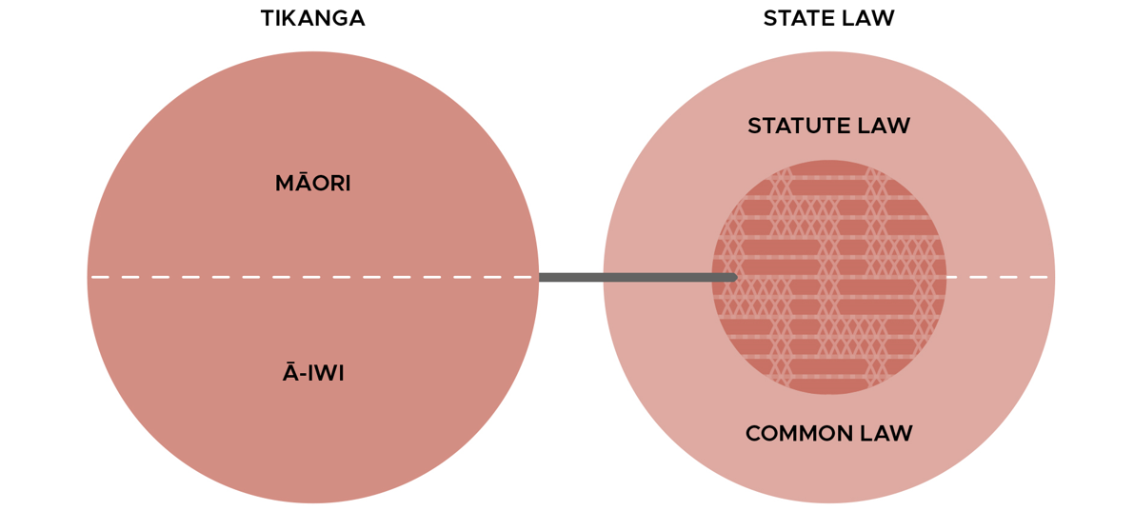
Tikanga and State law
Notes:
Aspirational – two systems interacting, developing weave with State law
Major internal debate as to label for body of tikanga referenced law
Idea of tikanga as separate system still controversial + notion of ‘weave” not yet a reality.
Seek to move tukutuku to space between
Interlegality (Roughan)
Te Iho nui (neutral – tapu and noa space in the whare where ideas are exchanged)

Slide 15
State law engagement
  Tikanga as custom
  Tikanga as values
  Tikanga as law (in te ao Māori)

Slide 16
Tikanga as custom
  Two types:
  Property rights (Wi Parata, Ngati Apa)
  General custom (Loasby, Ellis)

Slide 17
Tikanga values
Takamore – tikanga values form part of the common law
Notes:
Burial custom – significant development – move away from rigid custom to underlying values weaving

Slide 18
Tikanga as law (in te ao Māori)
Ellis – first law of New Zealand, still governs lives of Māori
Ngāti Whātua Ōrākei – Mana whenua

Slide 19
Illustrations
Tikanga now permeates Public, Treaty, Family and Environmental law
Tikanga is informing Criminal law, Equity, Employment law and Tort
Notes:
Detail on notable evolutions:
Principles provisions: Town and Country Planning Act 1977 and Resource Management Act 1991.
Requiring the decision-makers to take into account Māori interests: Children, Young Persons and Their Families Act 1989 (Oranga Tamariki Act 1989).

Slide 20
Illustrations
Debt - Doney v Adlam
Trustee duties – Kusabs v Staite
Employment contracts – GF v Customs
Notes:
Doney – tikanga aligned concept – debt
Kusabs – tikanga of whanaungatanga informed trust duties
GF – commitment to te Ao Māori values brought tikanga into focus, informed obligations.

Slide 21
Where to from here?
Lots of energy, but a slow weave

