Slide 1
Making ADR work for you – A Guide for In-house Counsel
Presented by Nicole Smith and Malcolm Wallace

Slide 2
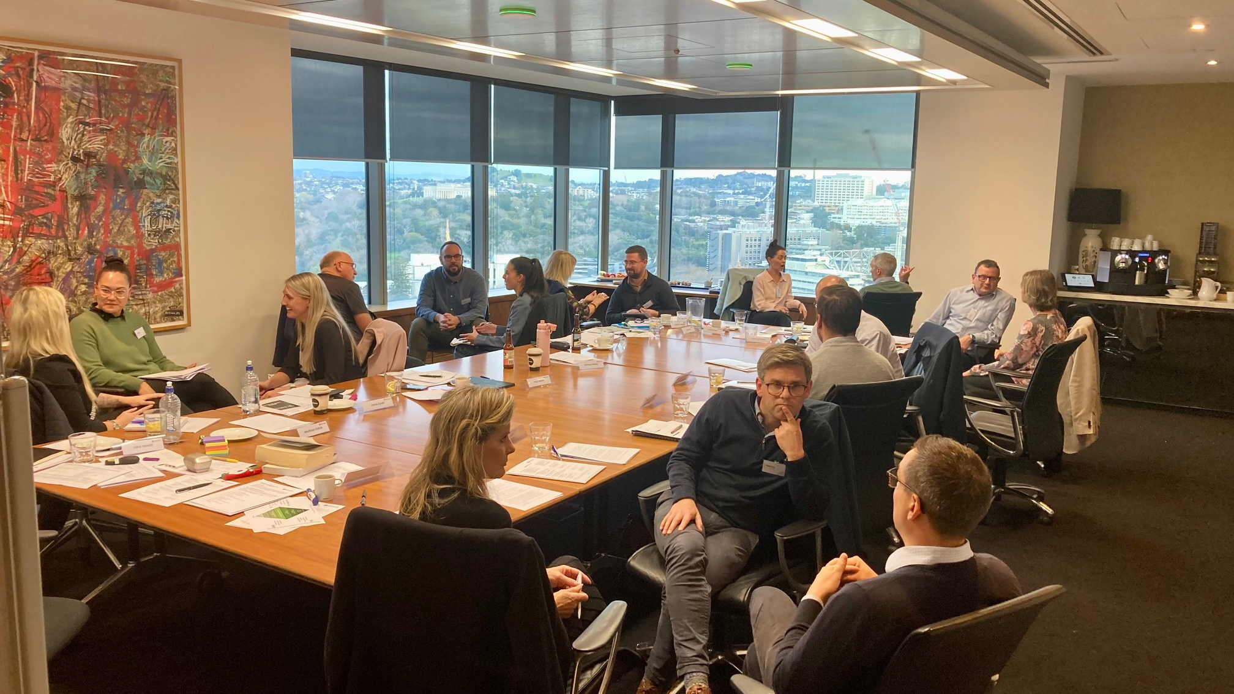
AMINZ
New Zealand’s lead organisation for dispute resolution professionals

Slide 3
Dispute resolution options: From peace pipes to freezing injunctions
Negotiation
Mediation
Expert Determination
Adjudication
Arbitration
Court

Slide 4
Confidentiality
The benefits and advantages of adopting an ADR process
Speed
Preserving
relationships
Cost
Quality

Slide 5
Lifting the lid –
how to get the most out of an Arbitration
Appointment
Planning
Documents
Pleadings
Hearings

Slide 6
Key aspects of mediation success
Preparation
Personnel
Attitude
Authority to settle
Documenting settlement

Slide 7
Should you draft your own dispute resolution clause?

Slide 8
Industry Templates
Model Dispute Resolution Clauses (including reference to mediation):
ADLS/REINZ
ADLS Commercial Lease

Slide 9
Clauses
Model Arbitration Clauses:
www.aminz.org – Arbitration clause for arbitrations under the AMINZ Rules:
The parties agree that any dispute or disagreement arising out of or in connection with this agreement will be settled by arbitration by [a sole arbitrator] in accordance with the AMINZ Arbitration Rules current at the time the arbitration is commenced. The place of arbitration will be [Auckland] and the law applicable to any issues in relation to the agreement to arbitrate, the arbitral proceedings [and the matters in dispute] will be [New Zealand law]
Ad hoc clause for arbitrations under the Arbitration Act 1996:
The parties agree that any dispute or disagreement arising out of or in connection with this agreement will be settled by arbitration by [a sole arbitrator]. The place of arbitration will be [Auckland] and the law applicable to any issues in relation to the agreement to arbitrate, the arbitral proceedings [and the matters in dispute] will be [New Zealand law].

Slide 10
Contact
Nicole Smith
Email: nicole@nicolesmith.co.nz
Mobile: 021 175 9014
Website: www.nicolesmith.co.nz
Malcolm Wallace
Email: wallace@freedomchambers.co.nz
Mobile: 027 260 3431
Website: www.malcolmwallace.co.nz
www.aminz.org.nz

