Slide 1


Fast-track Approvals
Act 2024
Insights from within the one-stop-shop

Slide 2
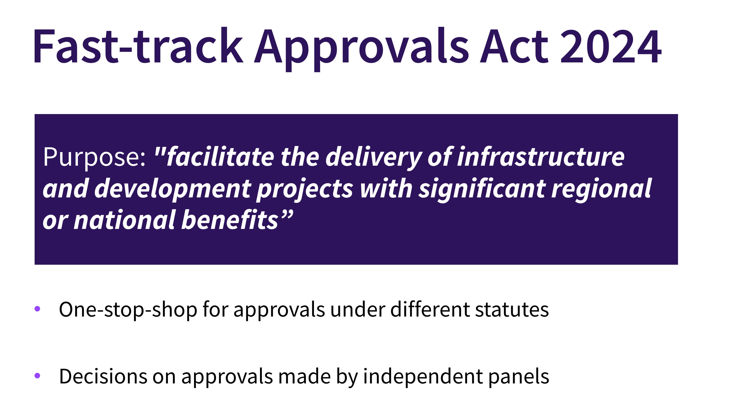
Fast-track Approvals Act 2024
Purpose: "facilitate the delivery of infrastructure and development projects with significant regional or national benefits”
One-stop-shop for approvals under different statutes
Decisions on approvals made by independent panels

Slide 3
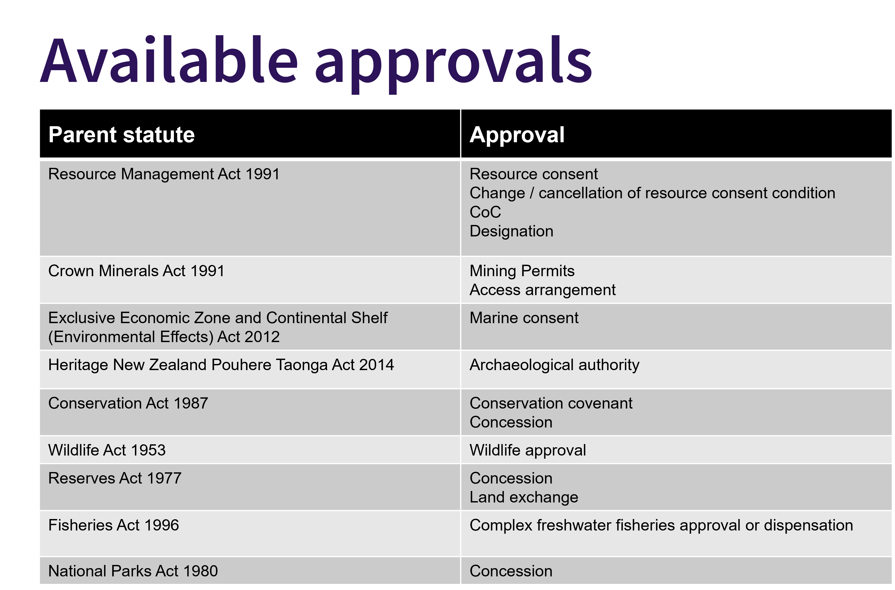

Slide 4
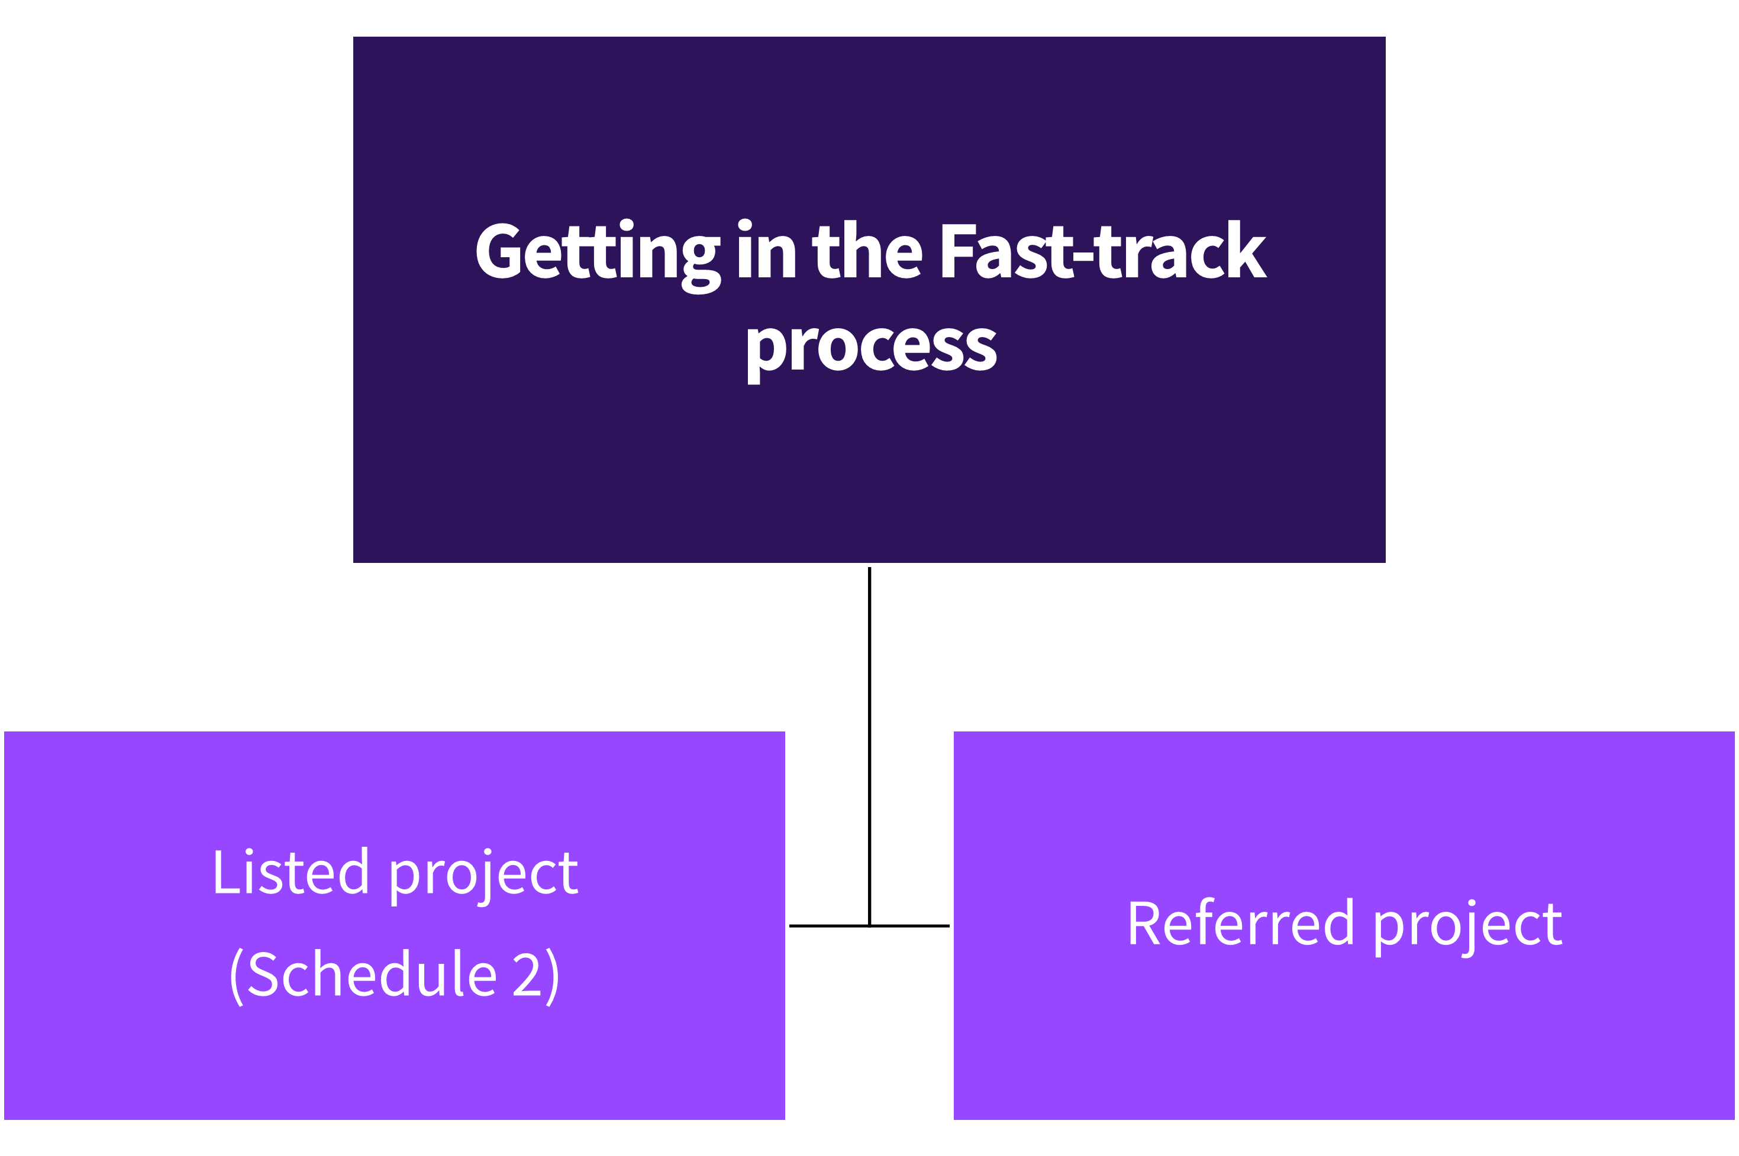

Slide 5


Slide 6
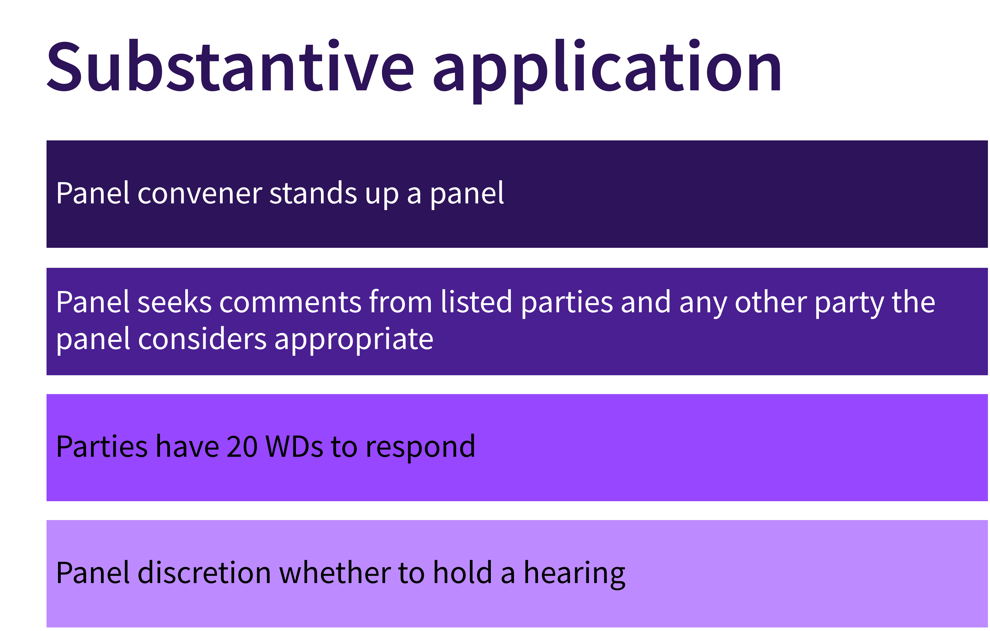

Slide 7


Slide 8
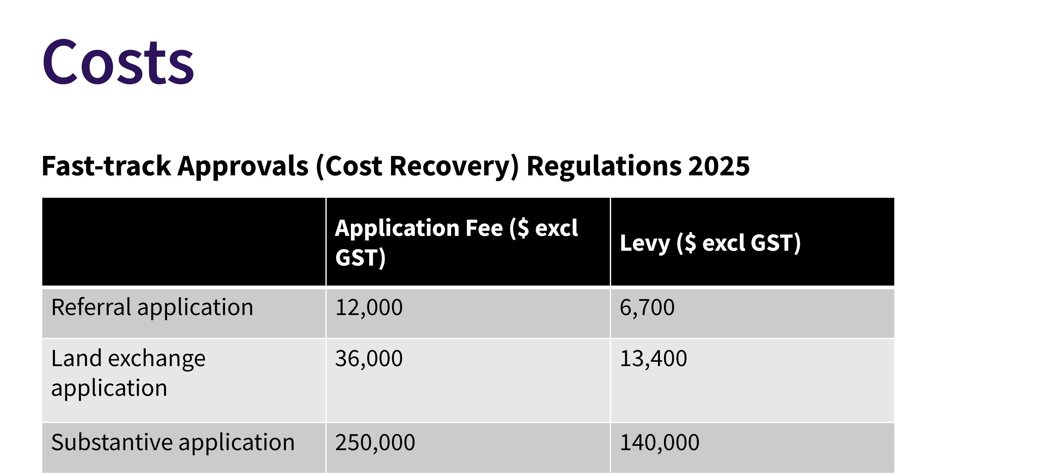

Slide 9
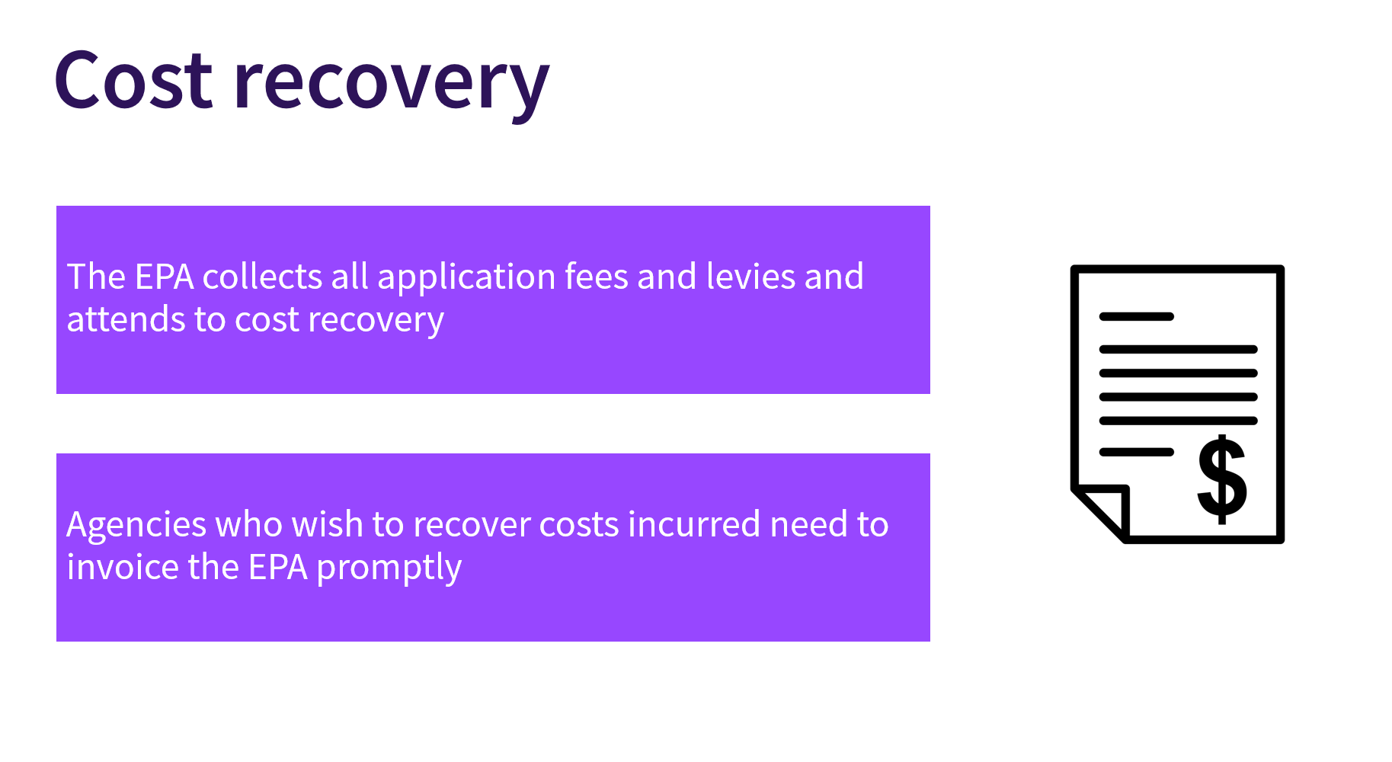

Slide 10


